Slide 1


AASD 4004
Machine Learning - II
Applied AI Solutions Developer Program

Slide 2
Module 09 Image Processing
Vejey Gandyer

Slide 3
Agenda
Image Processing
Tasks of Image Processing
Image Basics
Drawing Shapes
Image Math
Color Spaces
Image Manipulations

Slide 4
Image Processing
What is it?

Slide 5
Image Processing
Refers to the task of processing digital images

Slide 6
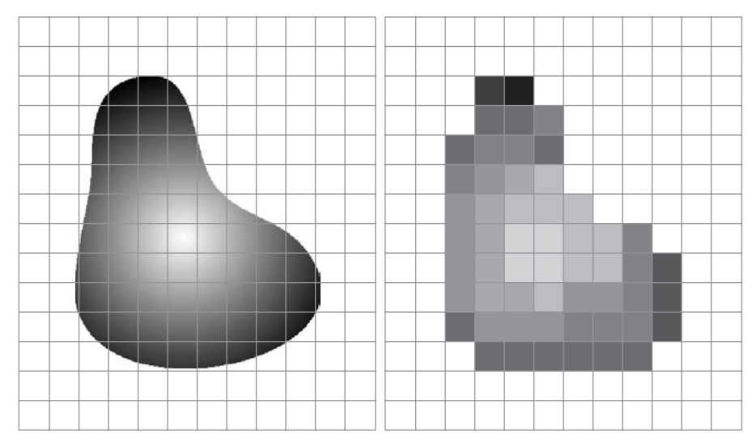
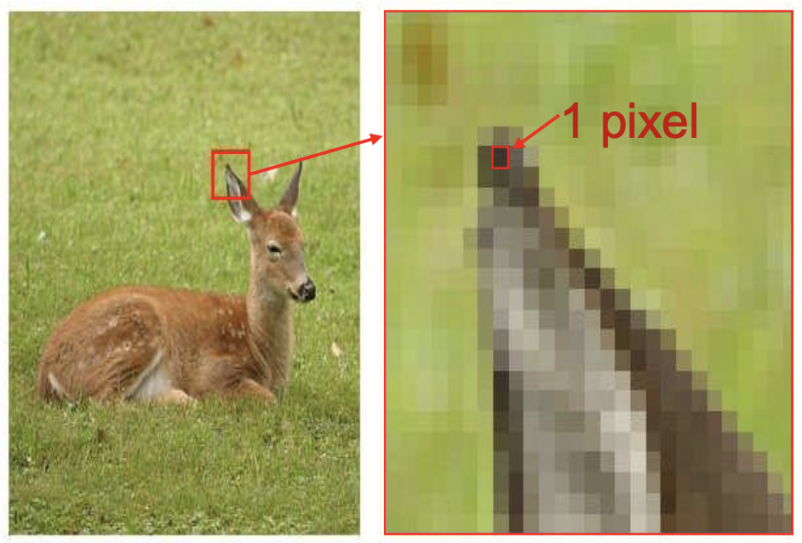
Image

Slide 7
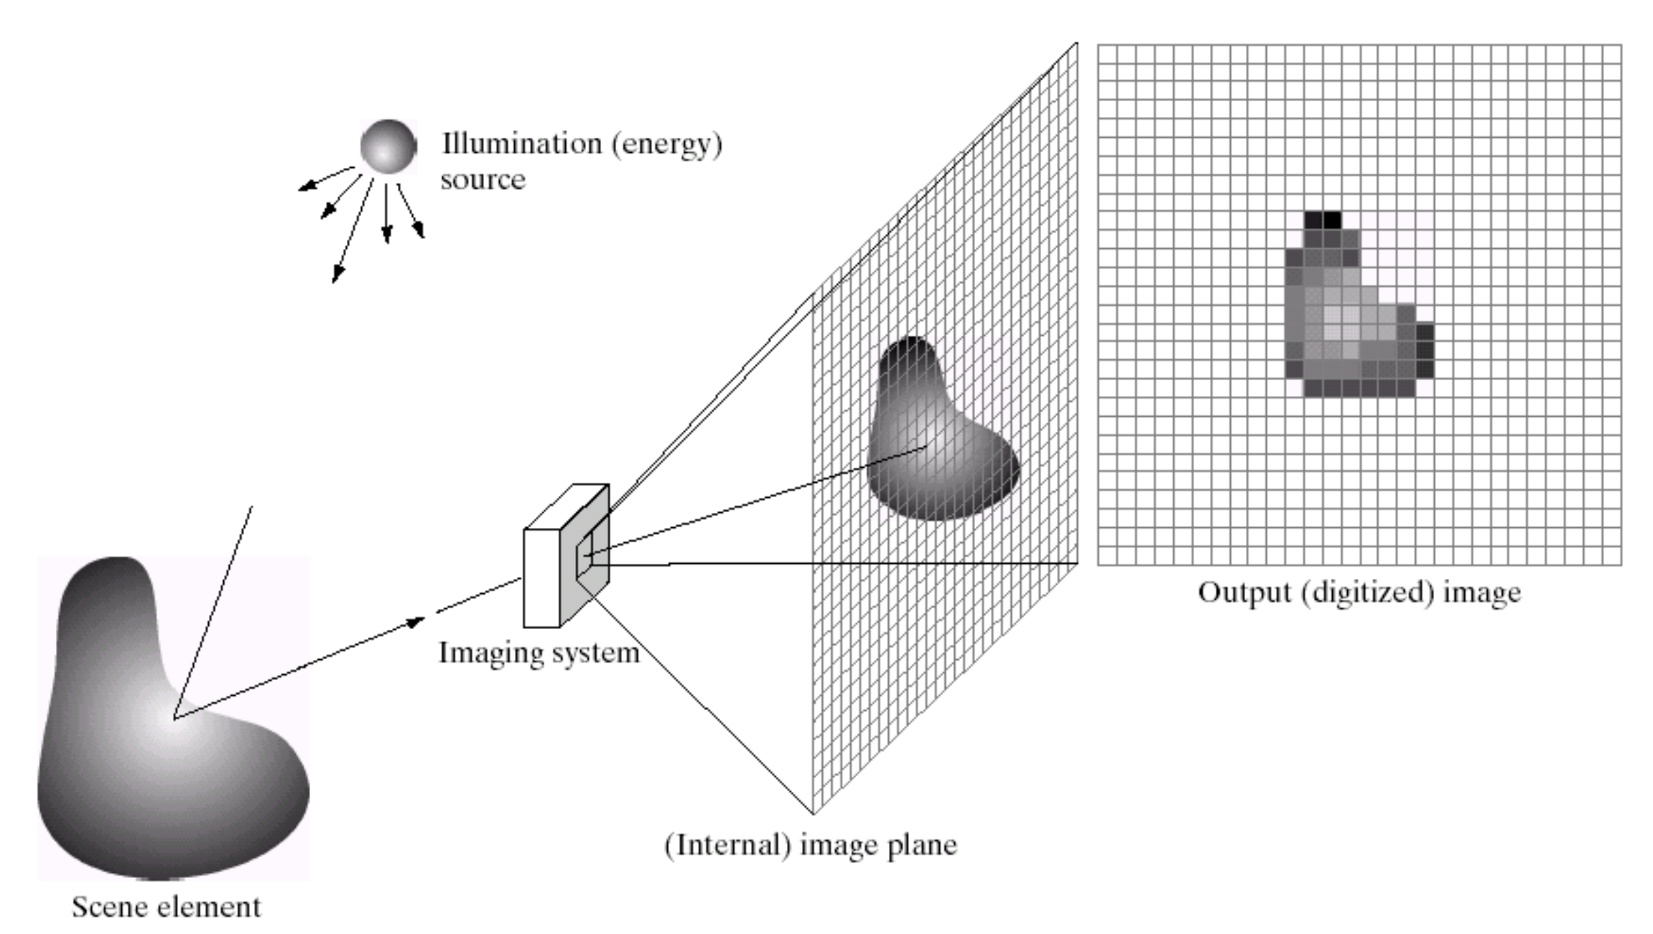
Digital Image

Slide 8
Digitization (Sampling)
A digital image is a representation of 2-dimensional image as a finite set of digital values – picture elements or pixels
Pixel values represent gray levels, colors, …
Digitization – an approximation of real scene

Slide 9
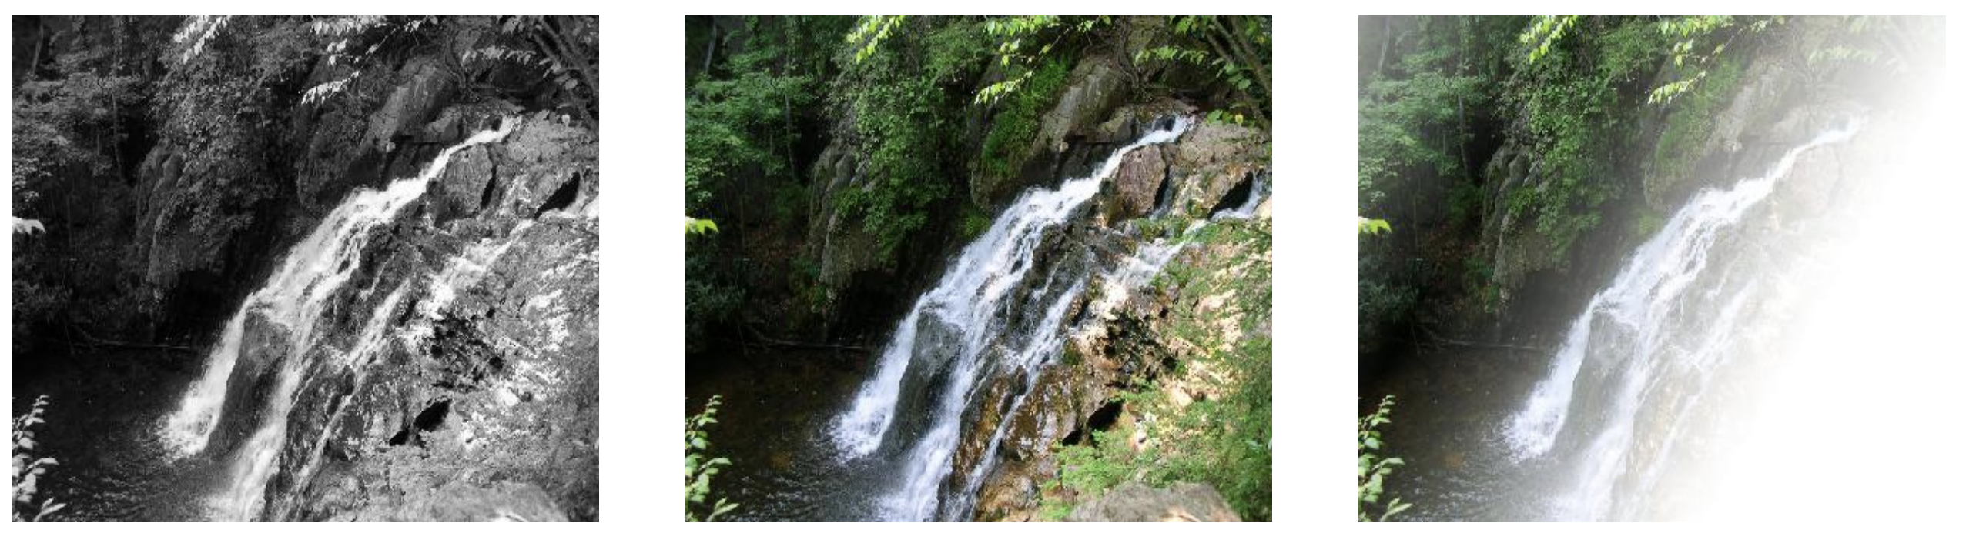
Image formats
Grayscale – 1 sample per point
RGB – 3 samples per point (Red, Green, Blue)
Alpha – 4 samples per point (Red, Green, Blue, Alpha)

Slide 10
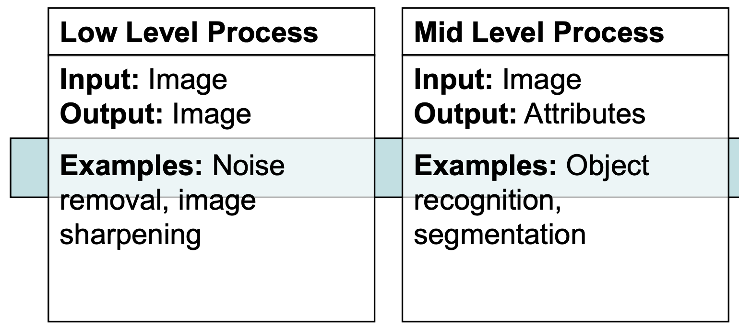
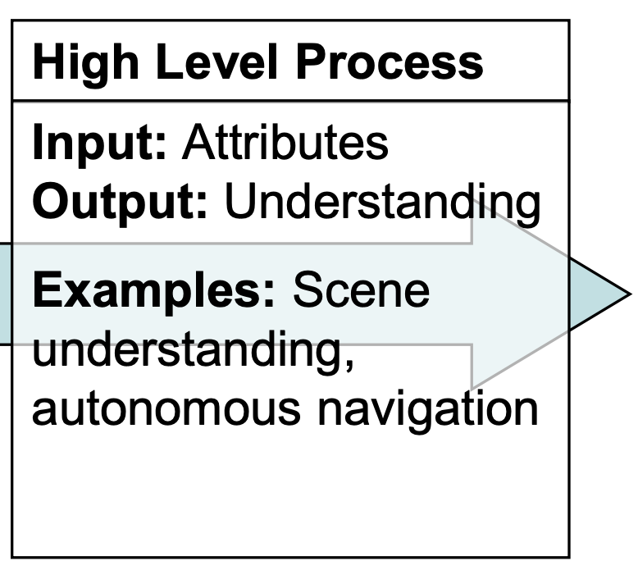
Levels of Image Processing

Slide 11
Tasks of Image Processing

Slide 12
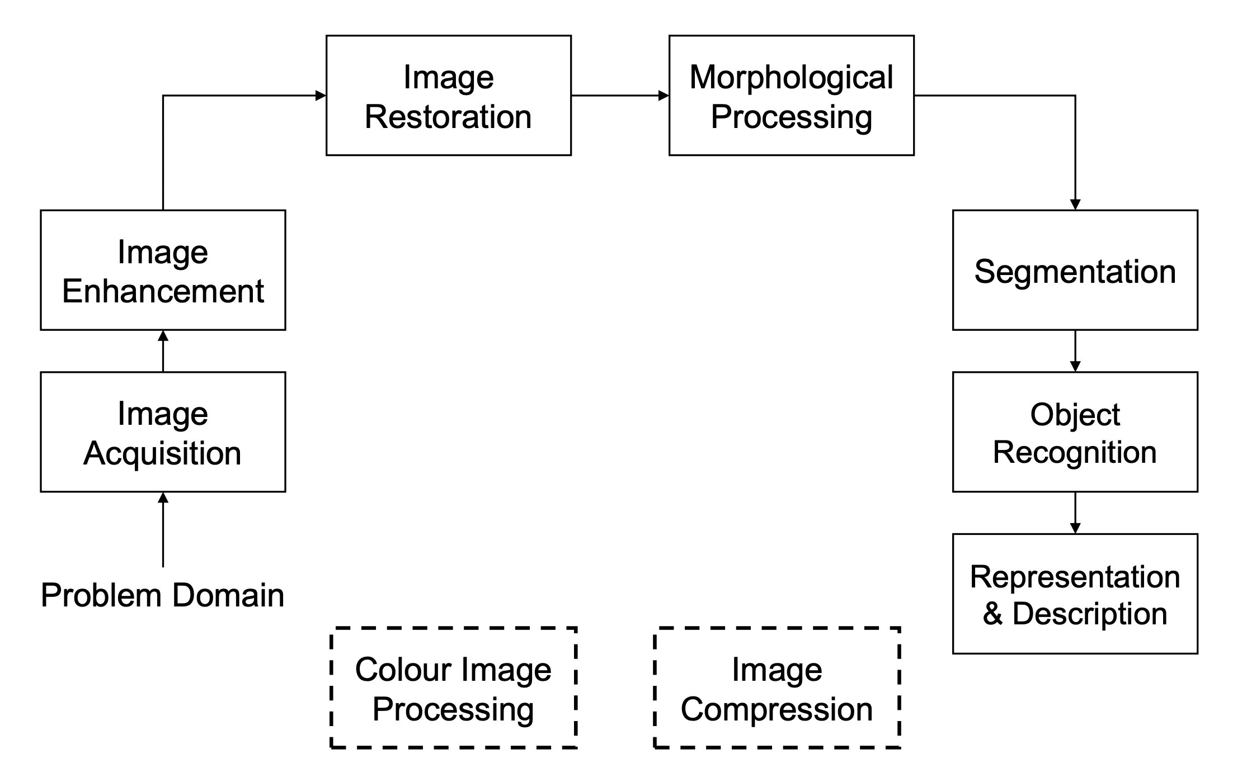
Tasks of Image Processing

Slide 13
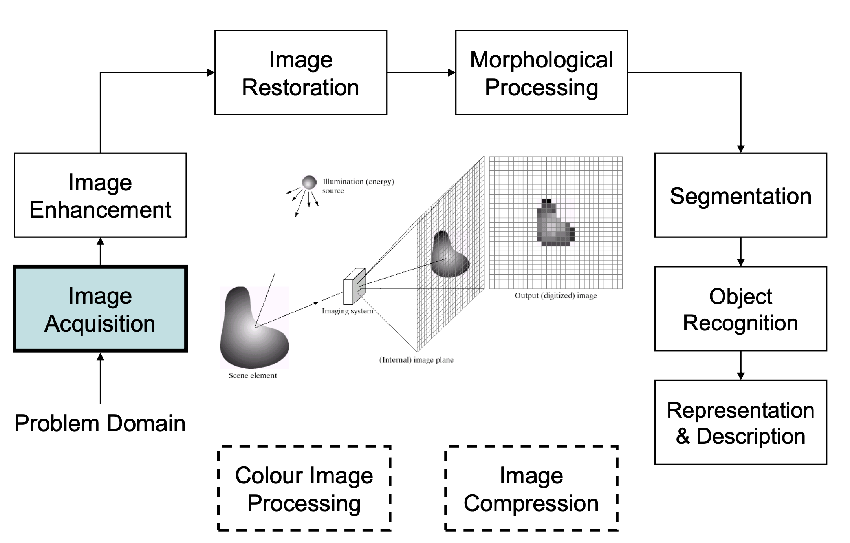
Image Acquisition

Slide 14
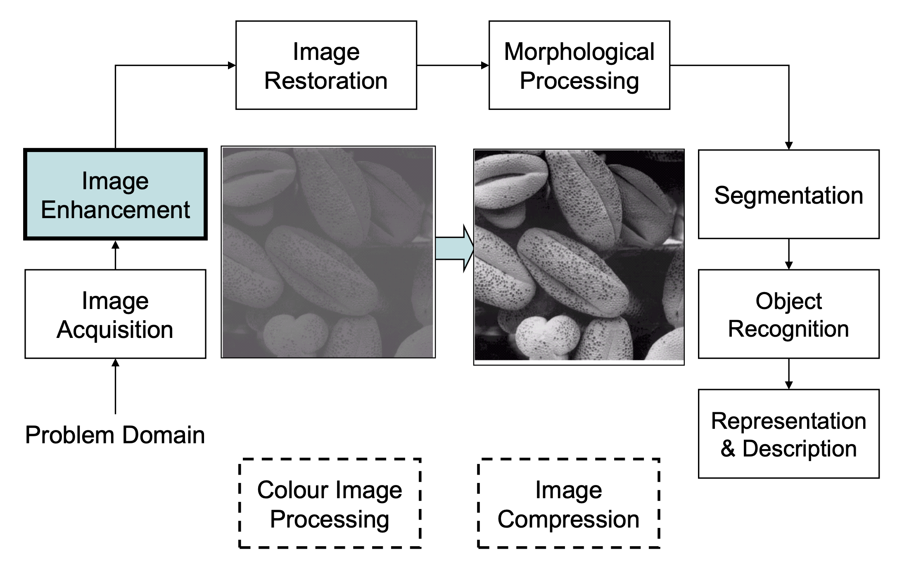
Image Enhancement

Slide 15
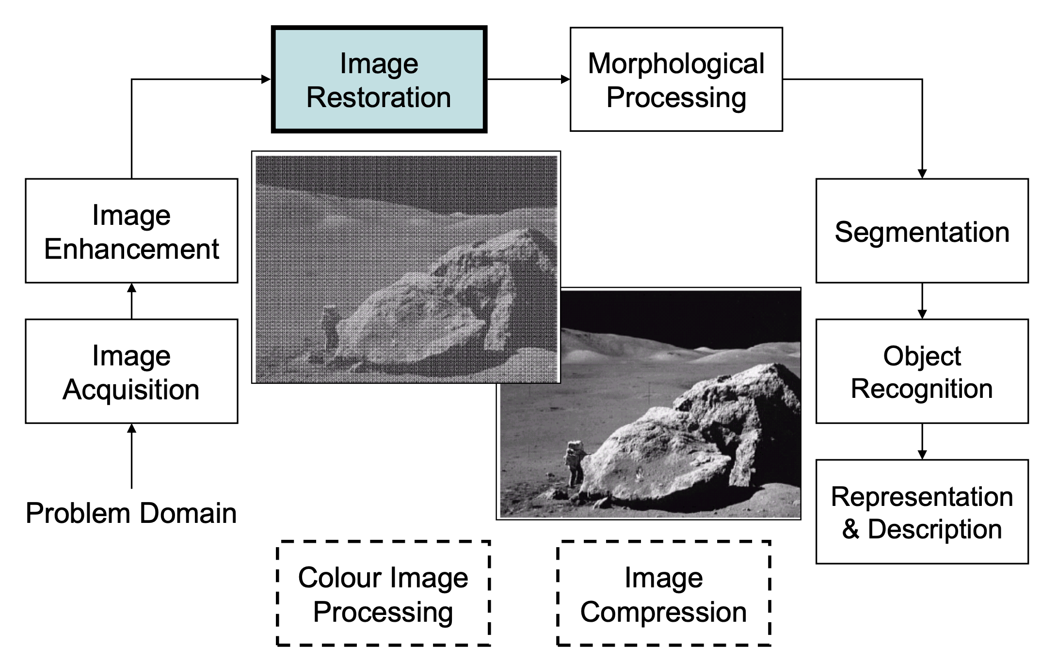
Image Restoration

Slide 16
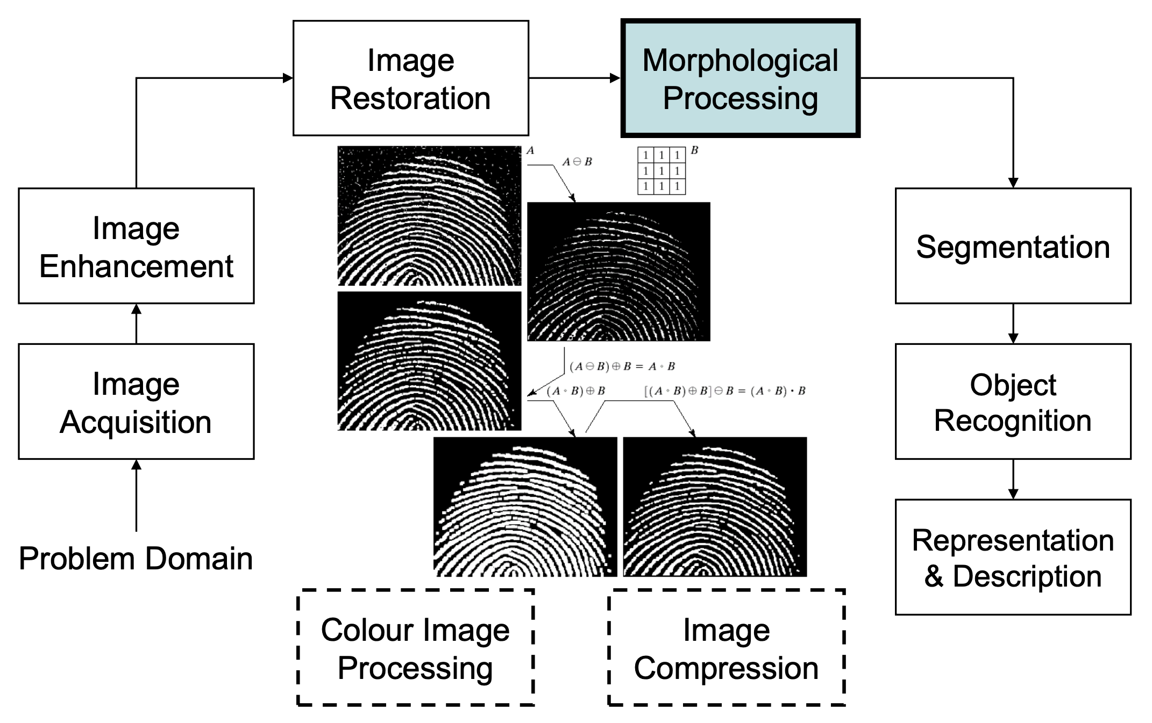
Image Morphology

Slide 17
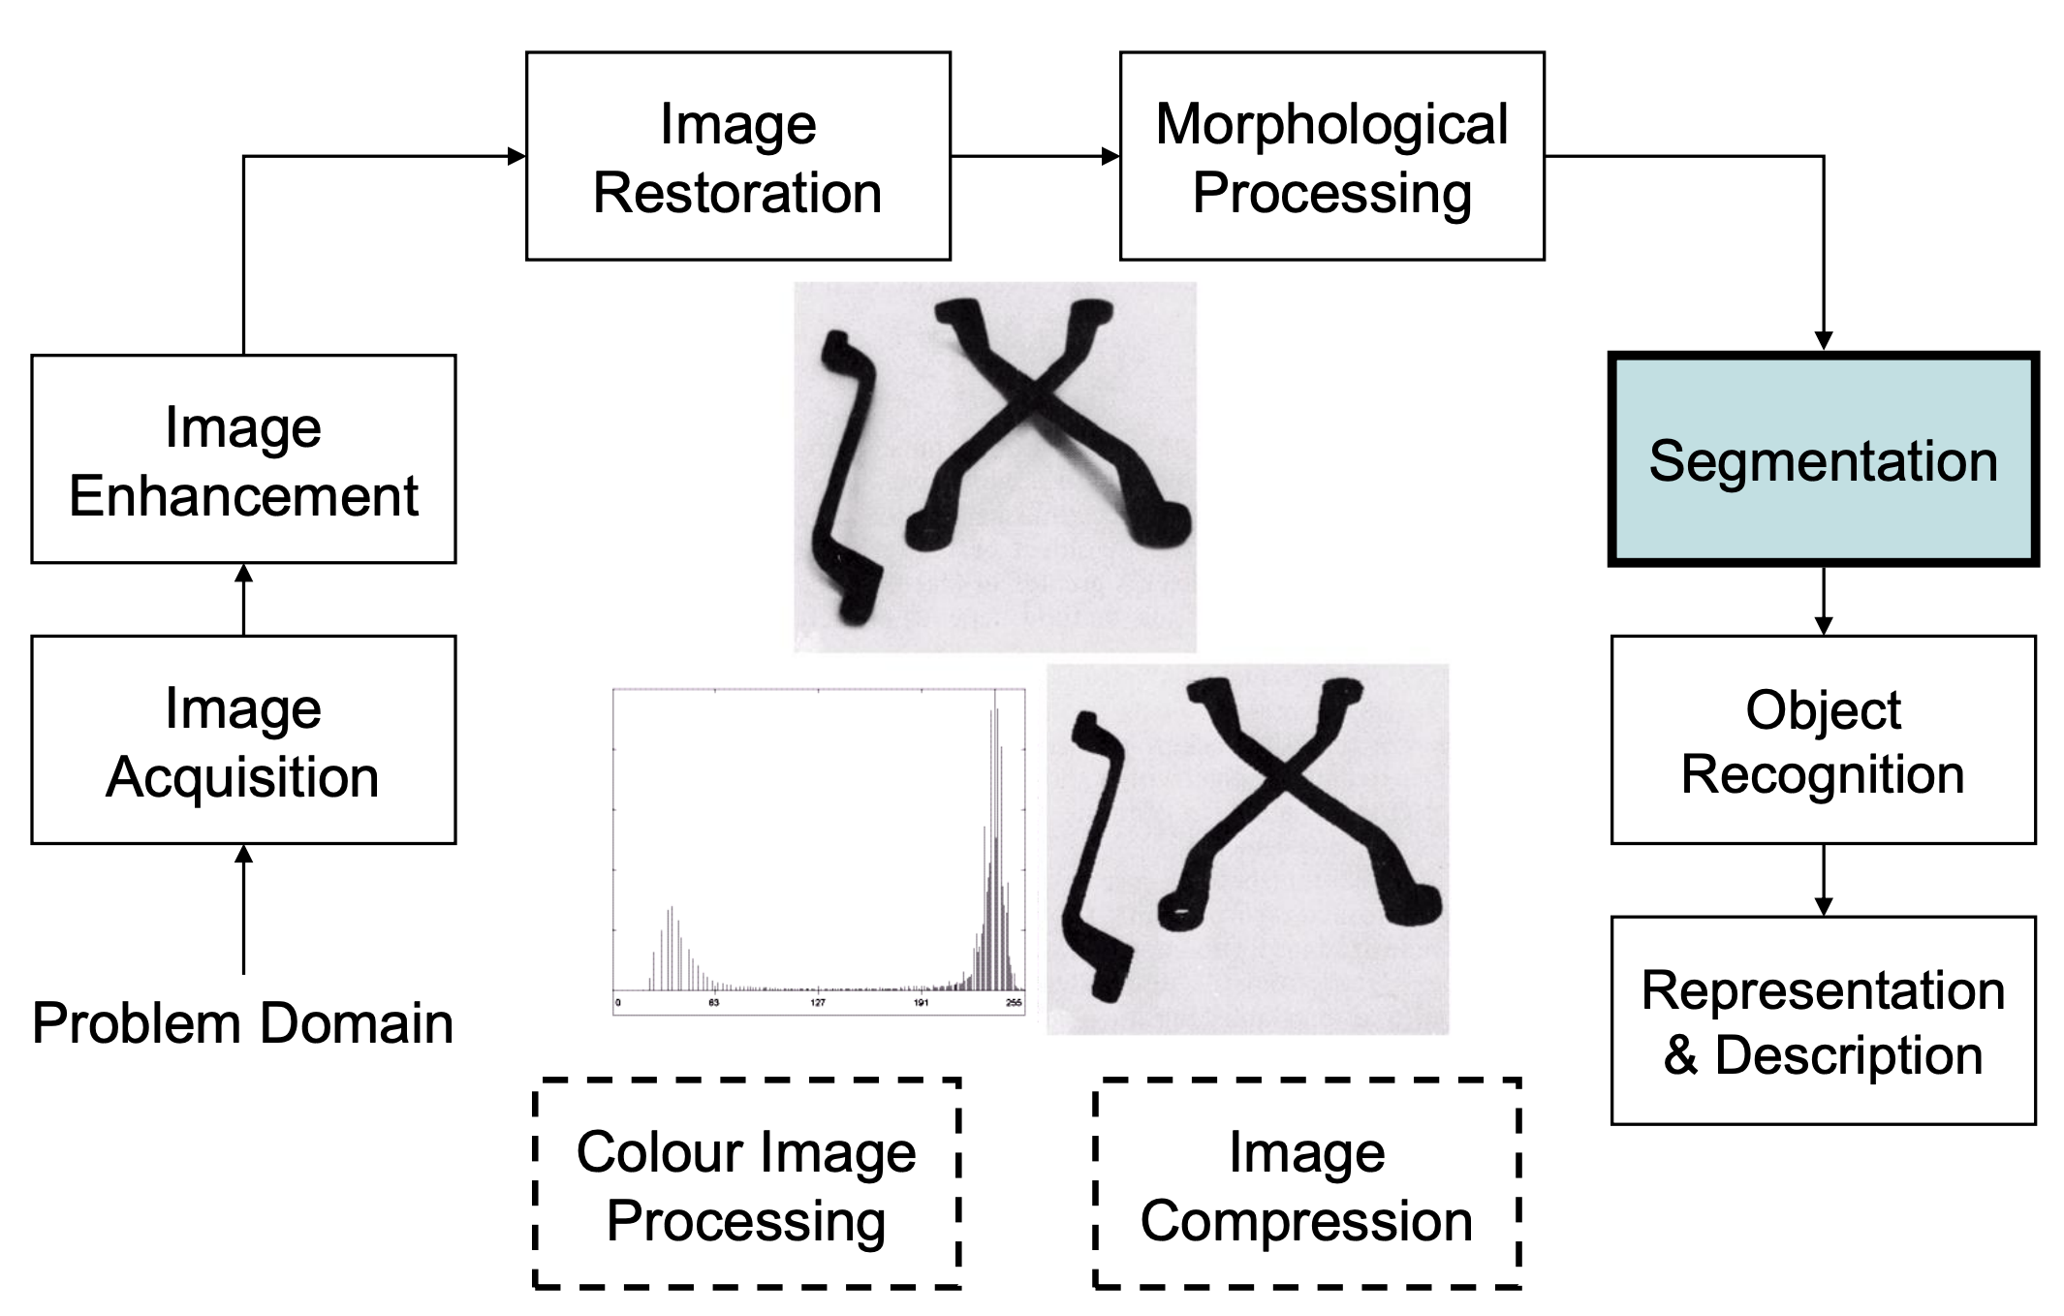
Image Segmentation

Slide 18
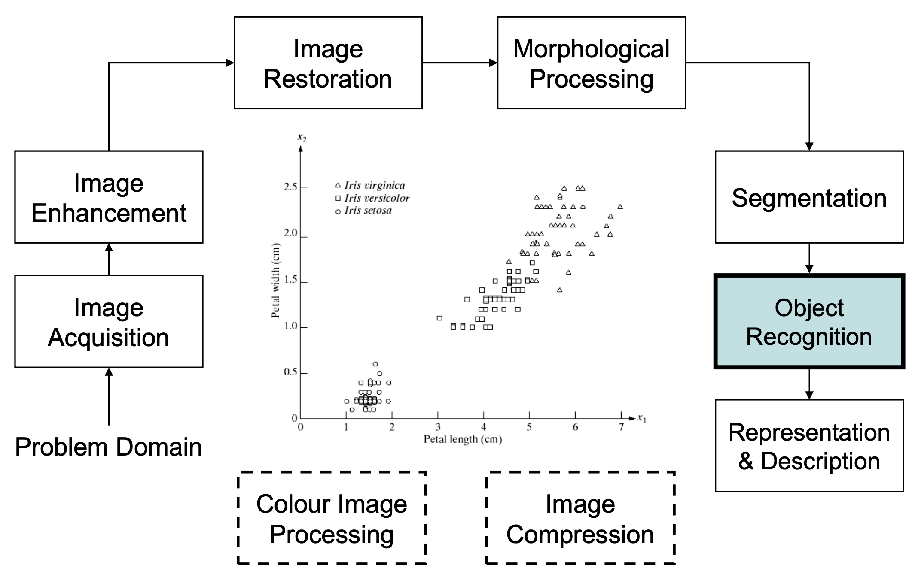
Image Object Recognition

Slide 19
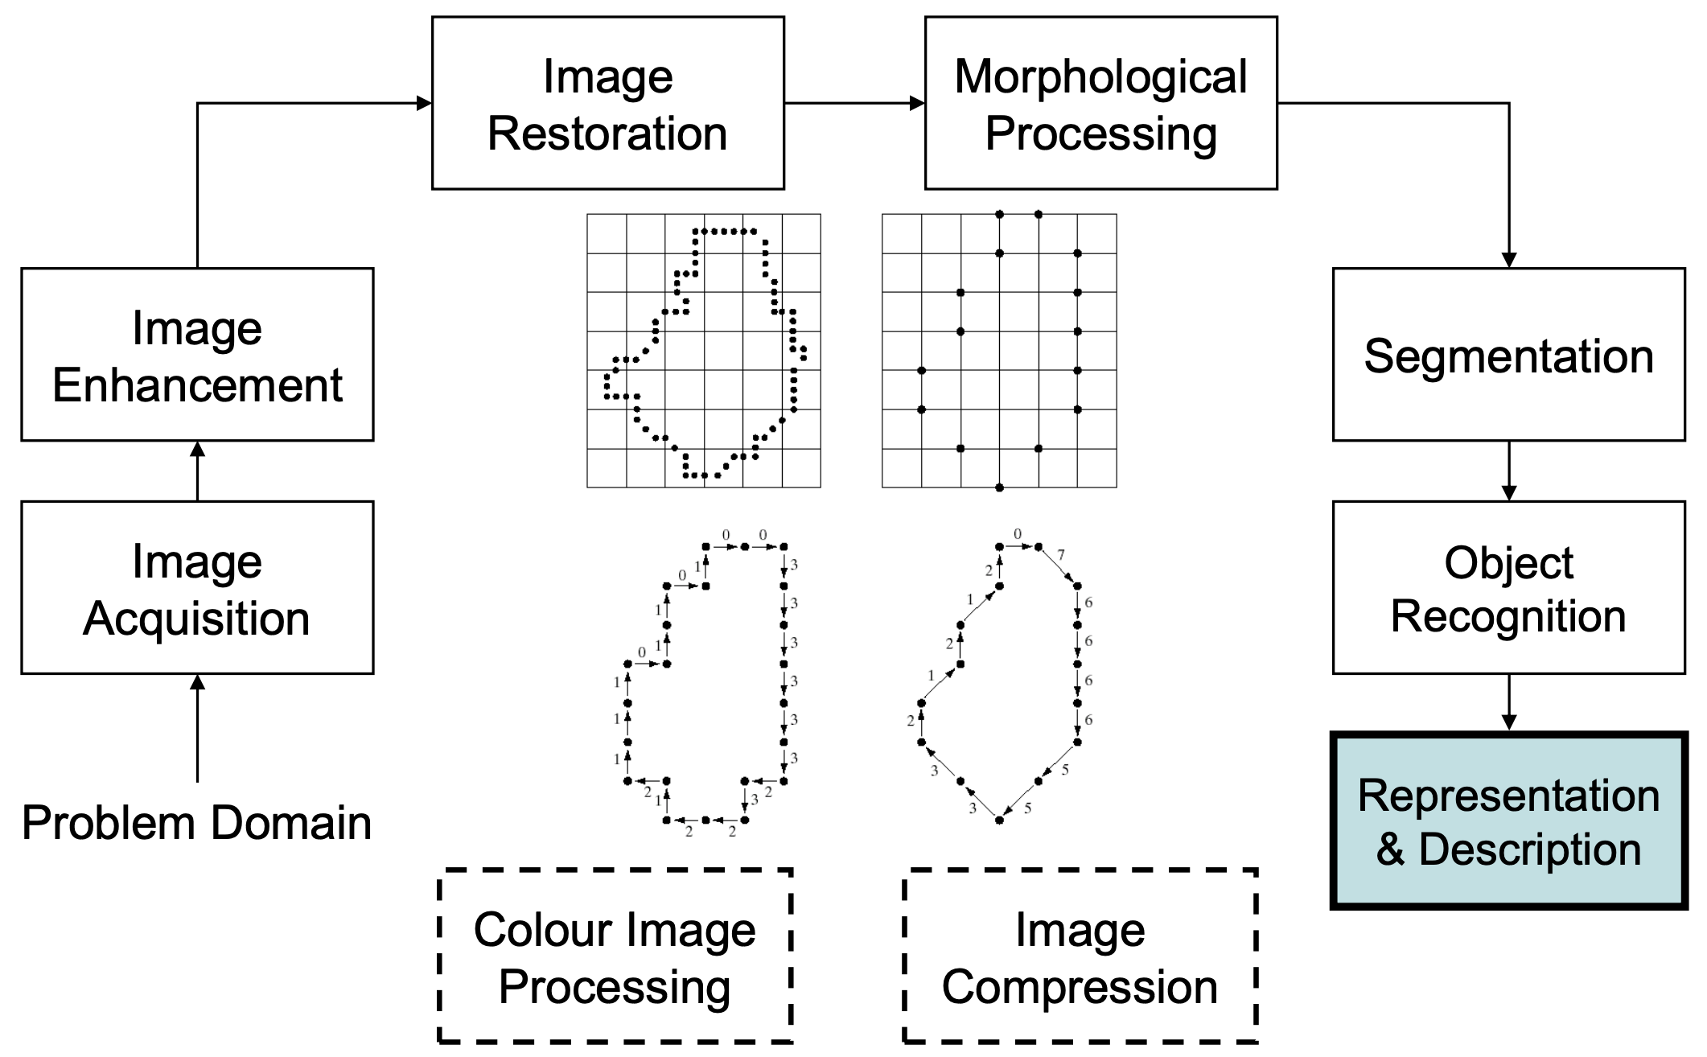
Image Representation

Slide 20
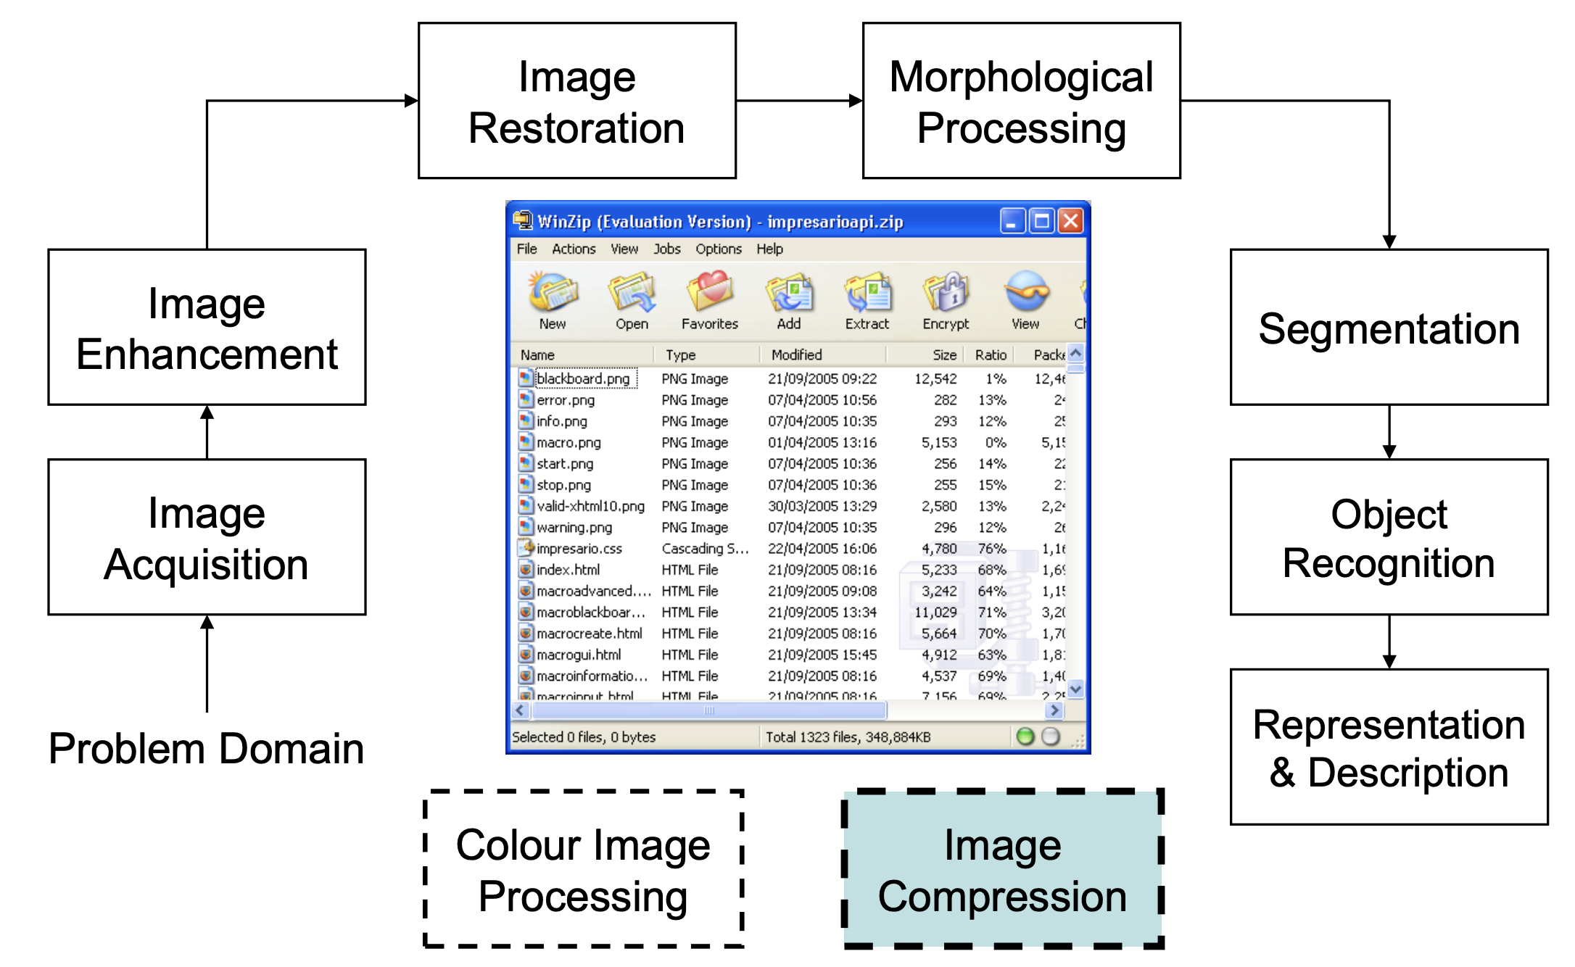
Image Compression

Slide 21
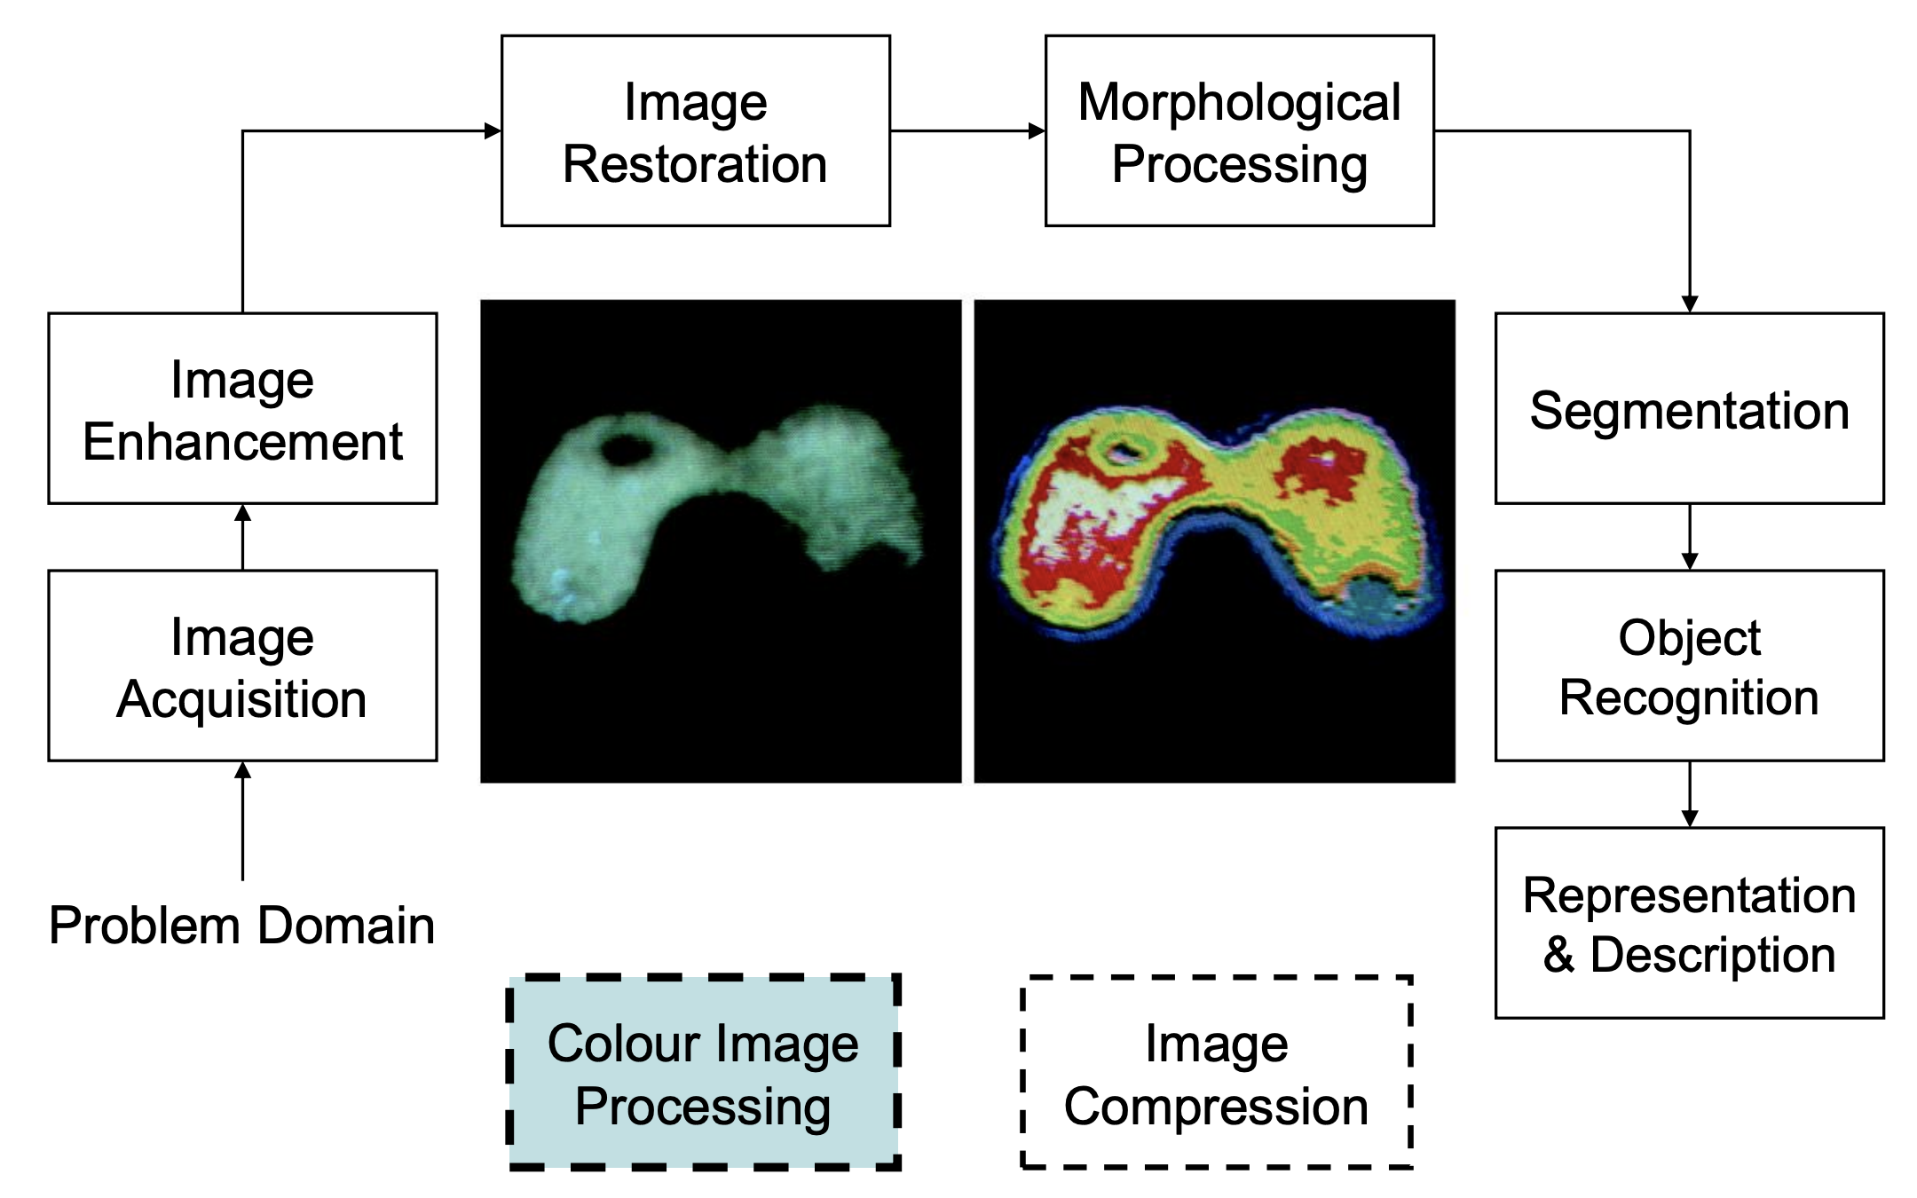
Image Color Processing

Slide 22
OpenCV

Slide 23
OpenCV Installation
mac
pip install opencv-python
conda install opencv / conda install –c conda-forge opencv
Windows
pip install opencv-python

Slide 24
Image Basics

Slide 25
Image Basics
Loading an image
Details of an image
Displaying an image
Saving an image
Slicing an image

Slide 26
Loading an image
imread( )
Reads an image and stores them in a NumPy array

Slide 27
Details of an image
Width
Height
Channels
Get details about the image

Slide 28
Displaying an image
imshow( )
Displays an image in a window
waitKey( )
Expects a keypress to hold the display

Slide 29
Saving an image
imwrite( )
Saves an image in a file

Slide 30
Slicing an image
Image[ 0:100, 0:100 ]
Slices an image with the specified pixels

Slide 31
Drawing Shapes

Slide 32
Drawing Shapes
Line
Rectangle
Circle

Slide 33
Drawing a line
line( )
Draws a line

Slide 34
Drawing a rectangle
rectangle( )
Draws a rectangle

Slide 35
Drawing a circle
circle( )
Draws a circle

Slide 36
Image Math

Slide 37
Image Math
Add
Subtract
Bitwise

Slide 38
Add
add( )
Image enhancer

Slide 39
Subtract
subtract( )
Image enhancer

Slide 40
Bitwise
bitwise_and( )
If both pixel values > 0, pixel is turned ON else turned OFF
bitwise_or( )
If either pixel values > 0, pixel is turned ON else turned OFF

Slide 41
Bitwise
bitwise_xor( )
If both pixel values > 0, pixel is turned OFF
bitwise_not( )
If pixel values == 0, pixel is turned ON
If pixel values == 255, pixel is turned OFF

Slide 42
Color Spaces

Slide 43
Color Spaces
BGR
HSV
LaB
GrayScale

Slide 44
BGR Color Space
Split channels
Display channels
Merge channels
Conversion

Slide 45
Channels
split( )
Splits a BGR color image into Blue, Green, Red channels
merge( )
Merge different channels

Slide 46
Conversion
cvtColor( )
Grayscale – COLOR_BGR2GRAY
HSV – COLOR_BGR2HSV
LaB – COLOR_BGR2LAB

Slide 47
Image Manipulations

Slide 48
Image Manipulations
Crop
Flip
Mask

Slide 49
Crop
Removes the outer parts of the image that we are not interested
Image_array[ startY:endY, startX:endX ]

Slide 50
Flip
Changes the orientation of the image
- Horizontal
- Vertical
- Both Axes
flip( image, flip code)

Slide 51
Mask
Focus only on the portions of interest in an image
- Create a mask
- Apply mask
bitwise_and( image, image, mask )

Slide 52
Further Reading
Digital Image Processing 4th edition
Rafael Gonzalez & Richard Woods

